Slide 1
Design and Analysis of Algorithms
By Rahul Dixit

Slide 2
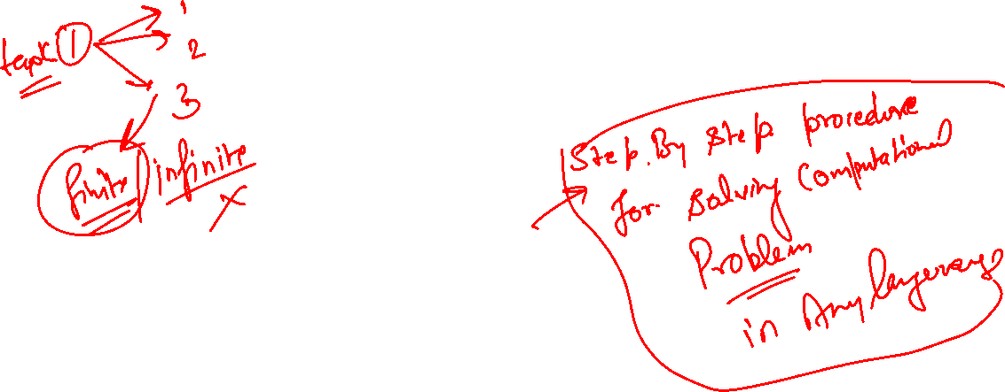
Unit 1: Introduction to Algorithm

Slide 3
Agenda
Introduction
The Role of an Algorithm
Fundamentals and Types of Algorithms
Fundamentals of Data Structures
Performance Analysis
Asymptotic Notations
Recursive and Non-Recursive Algorithms
Summary

Slide 4
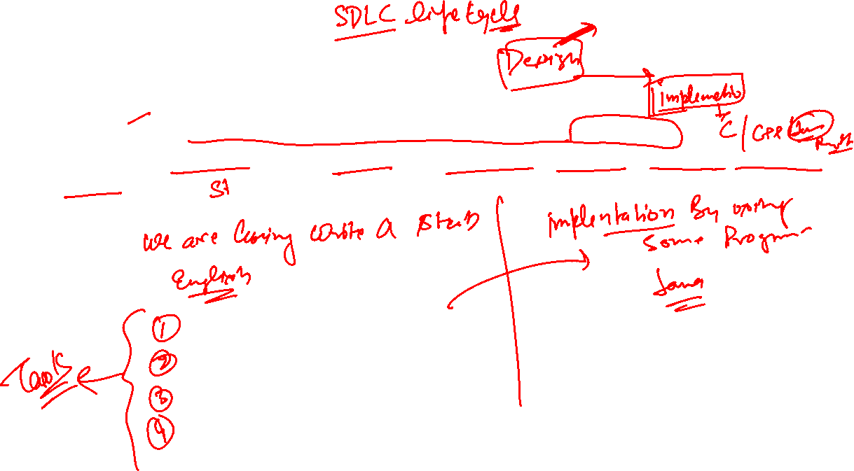
Introduction
An Algorithm, named for the ninth century Persian mathematician al-khowarizmi
It is simply a set of rules used to perform some calculations either by hand or more usually on a machine

Slide 5
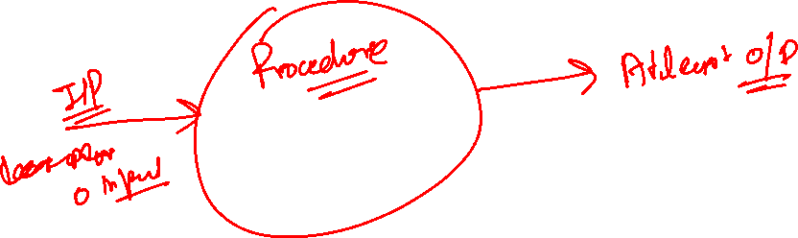
Informal Definition
An Algorithm is any well-defined computational procedure that takes some value
A set of values as Input and produces a set of values or some value as output.
Thus algorithm is a sequence of computational steps that transforms the i/p into the o/p.

Slide 6
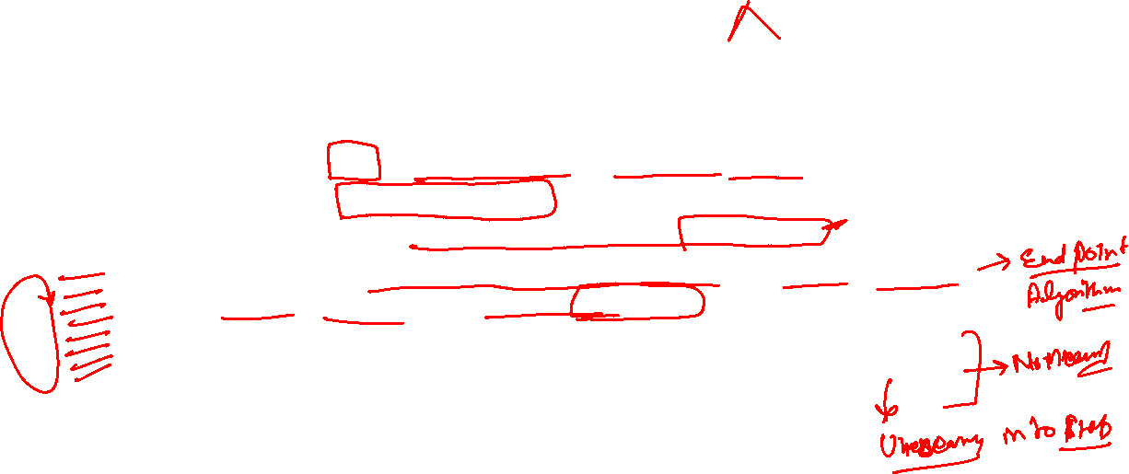
Formal Definition
An Algorithm is a finite set of instructions that, if followed, accomplishes a particular task
INPUT → Zero or more quantities are externally supplied.
OUTPUT → At least one quantity is produced.
DEFINITENESS → Each instruction is clear and unambiguous.
FINITENESS → If we trace out the instructions of an algorithm, then for all cases, the algorithm terminates after a finite number of steps.
EFFECTIVENESS → Every instruction must very basic so that it can be carried out, in principle, by a person using only pencil & paper.

Slide 7
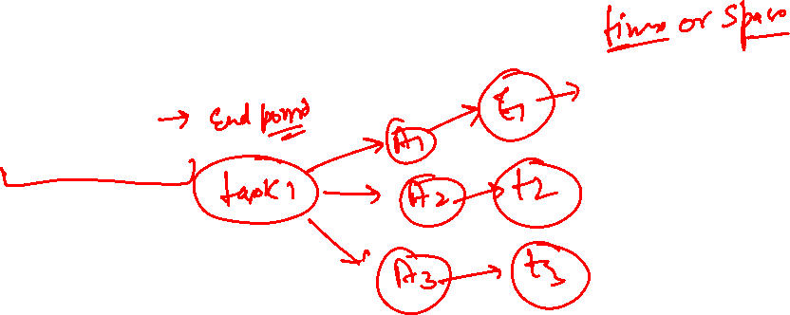
Issues Or Study Of Algorithm
How to device or design an algorithm → creating and algorithm.
How to express an algorithm → definiteness.
How to analysis an algorithm → time and space complexity.
How to validate an algorithm → fitness.
Testing the algorithm → checking for error.

Slide 8
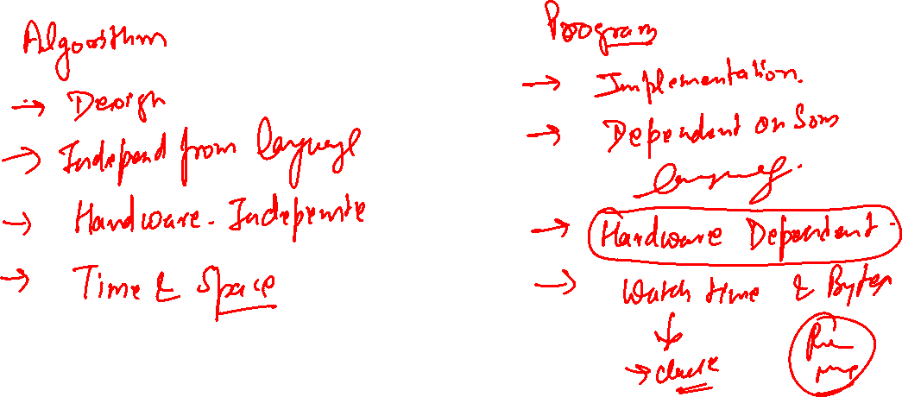

Slide 9
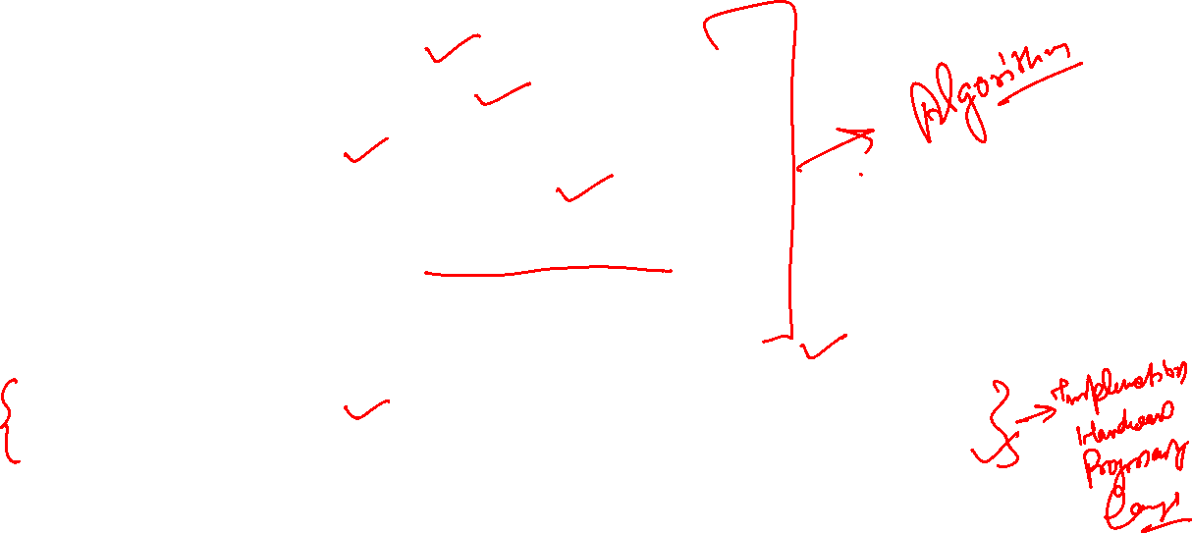
Step of Development
Problem statement
Constraints | Limitation
Design – logic
Express Also using flow chart
Validation : Checking correctness of algo (correct : it satisfies all the requirement in the given problem)
Analysis : in terms of Space or time complexity
Implementation
Testing and Debugging : give input and get desired output

Slide 10
Algorithm Specification
Natural language like English
Graphic representation called flowchart:
Pseudo-code Method

Slide 11
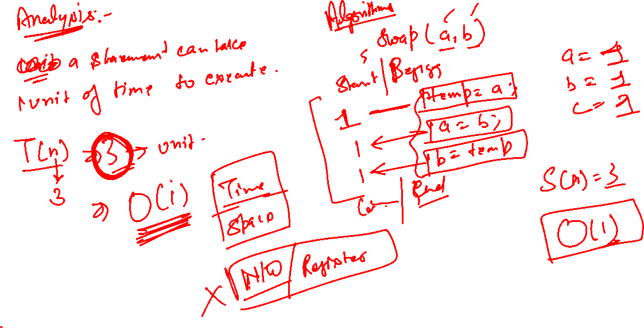

Slide 12
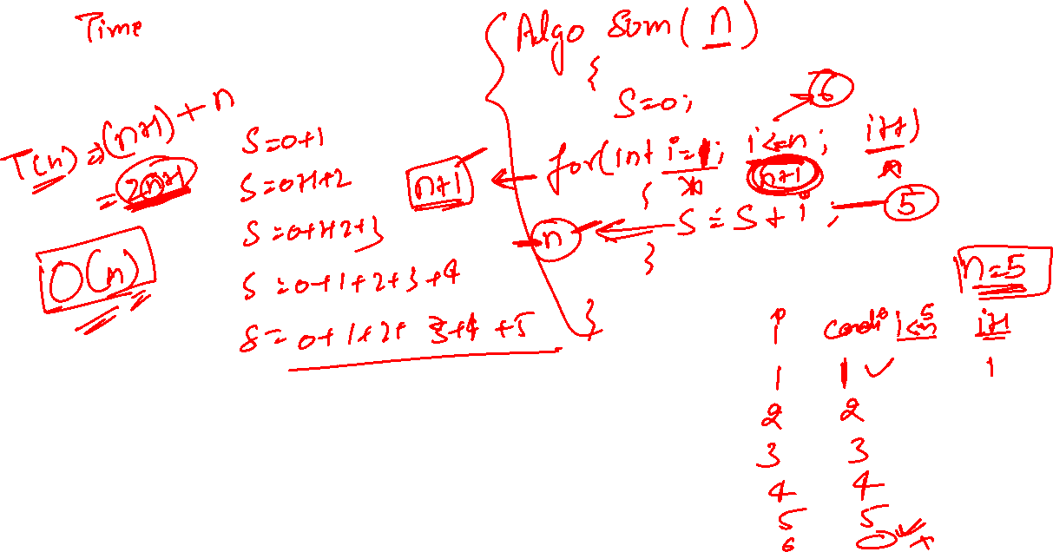

Slide 13
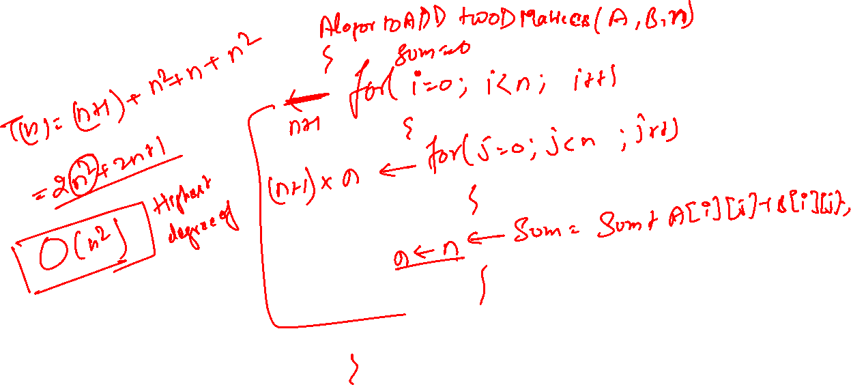

Slide 14
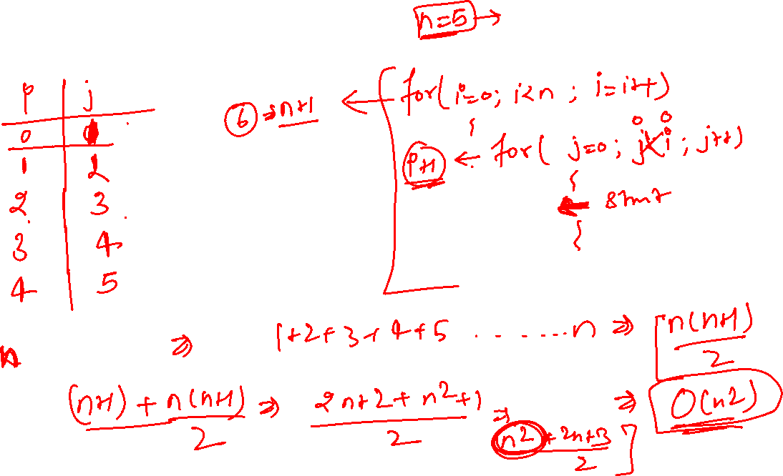

Slide 15
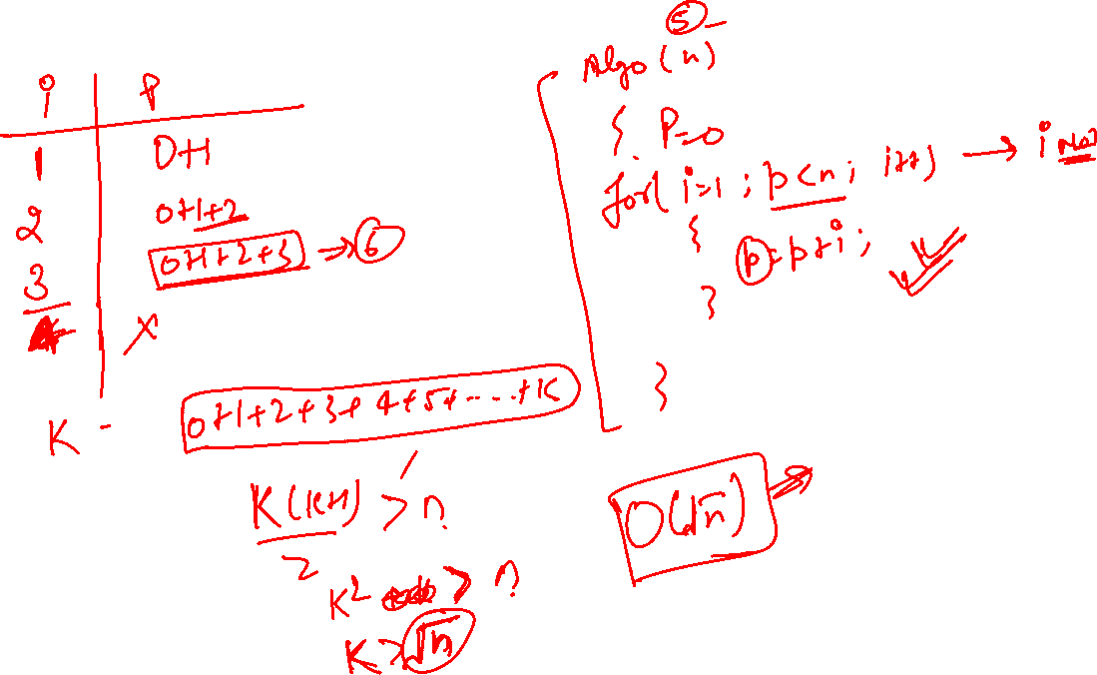

Slide 16
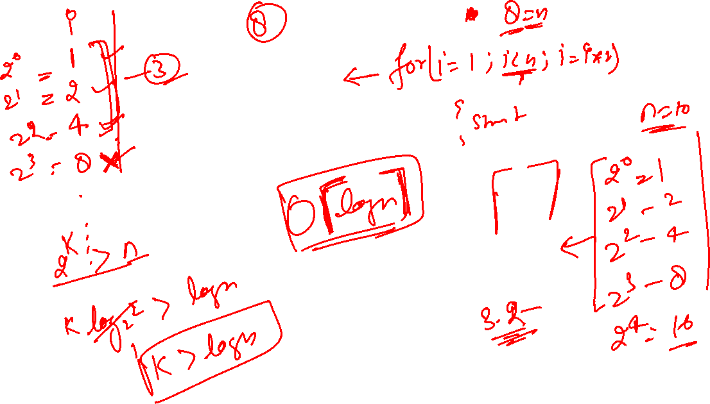

Slide 17
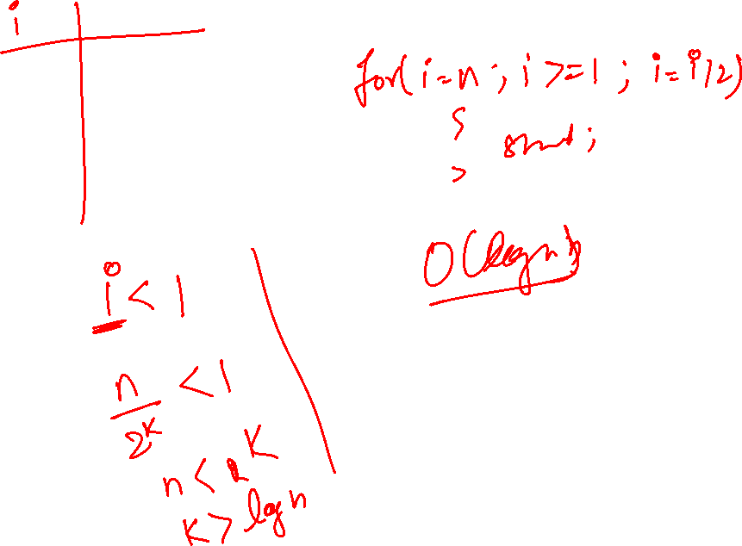

Slide 18
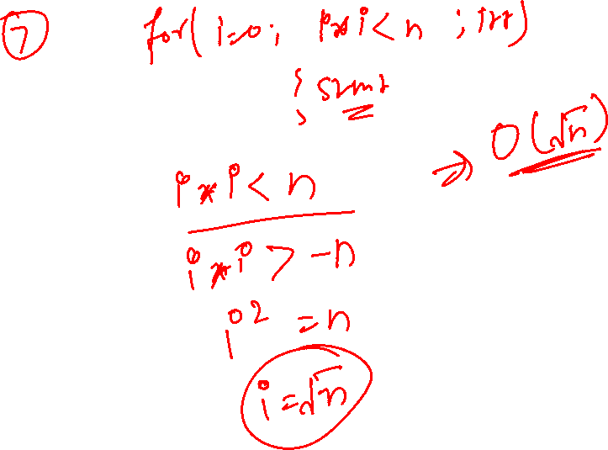

Slide 19
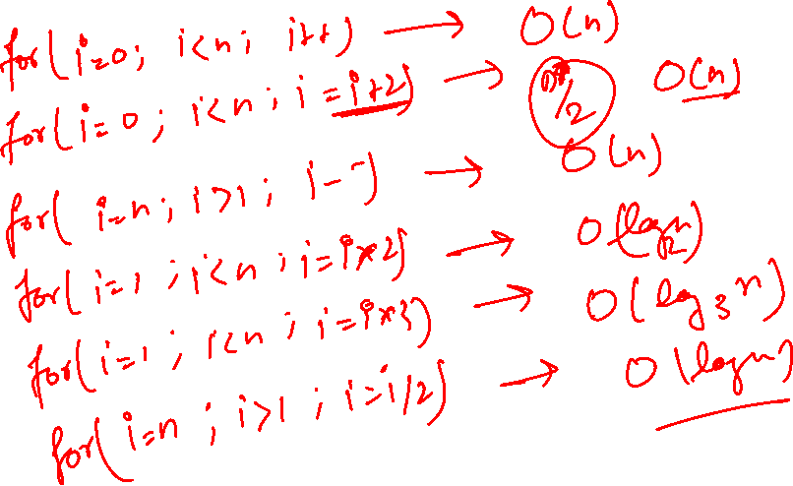

Slide 20
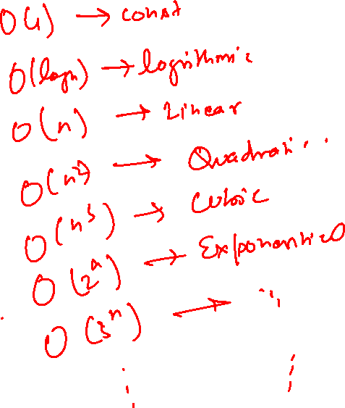

Slide 21

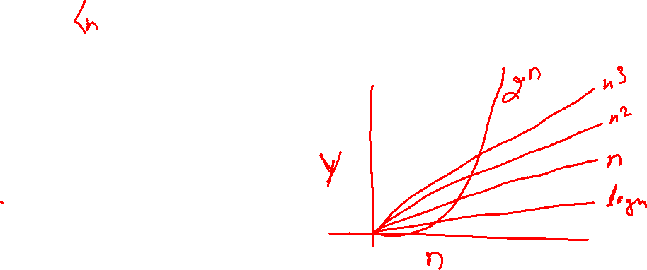
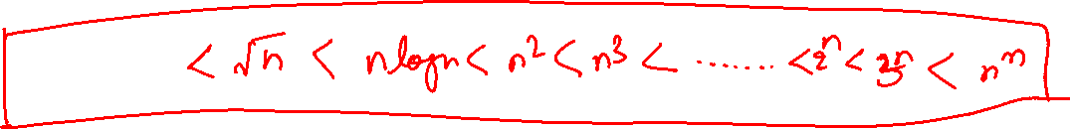
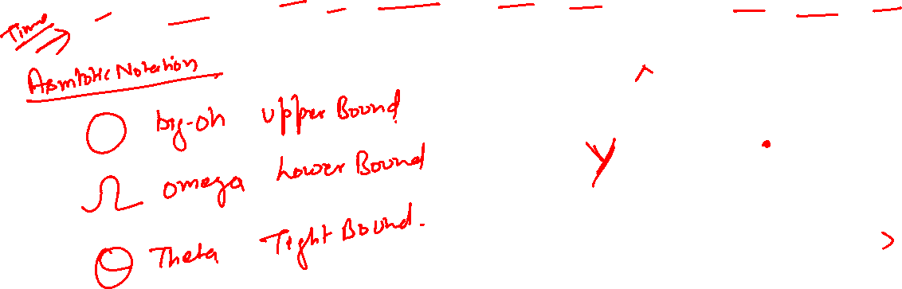

Slide 22
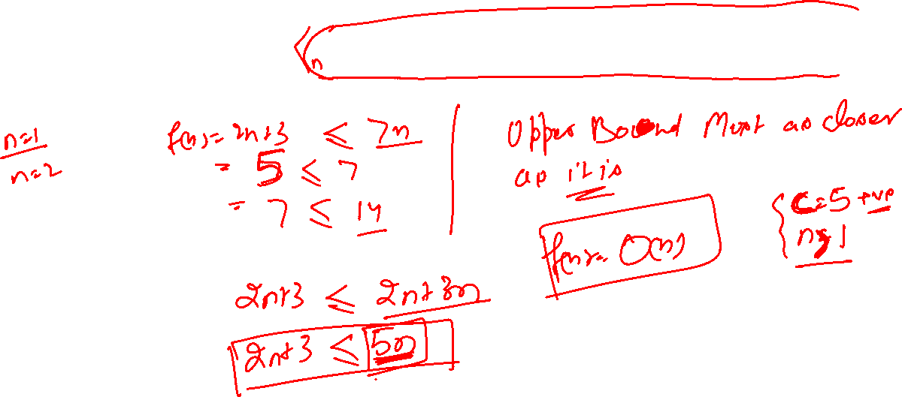


Slide 23
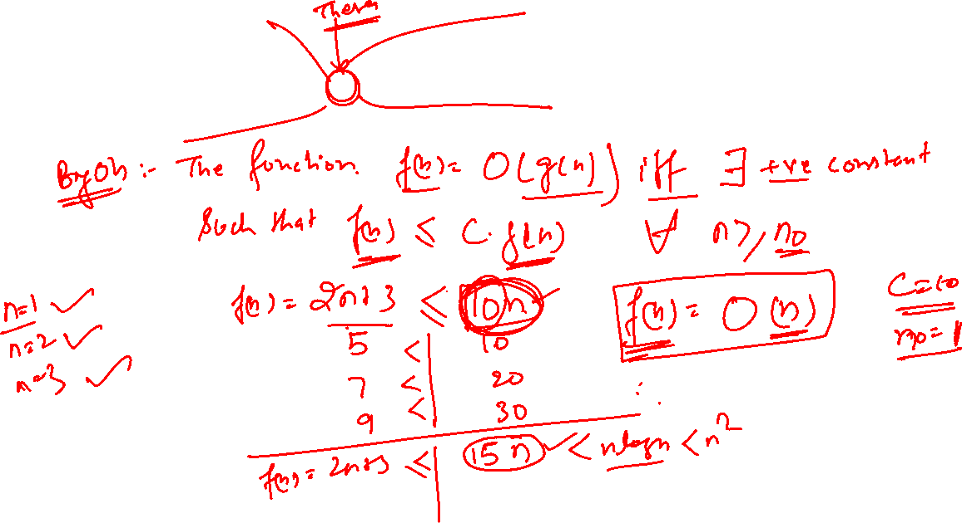


Slide 24
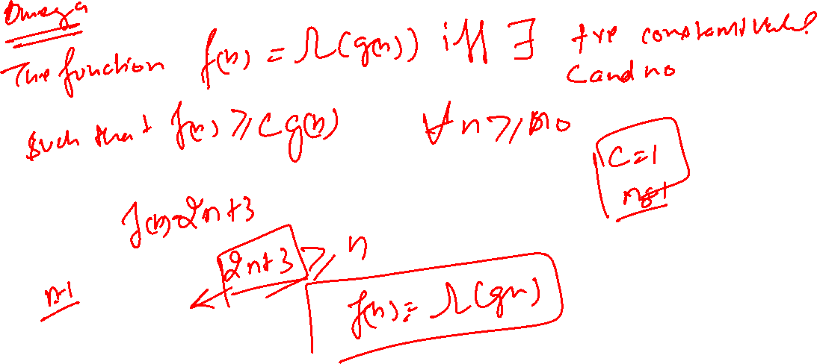

Slide 25
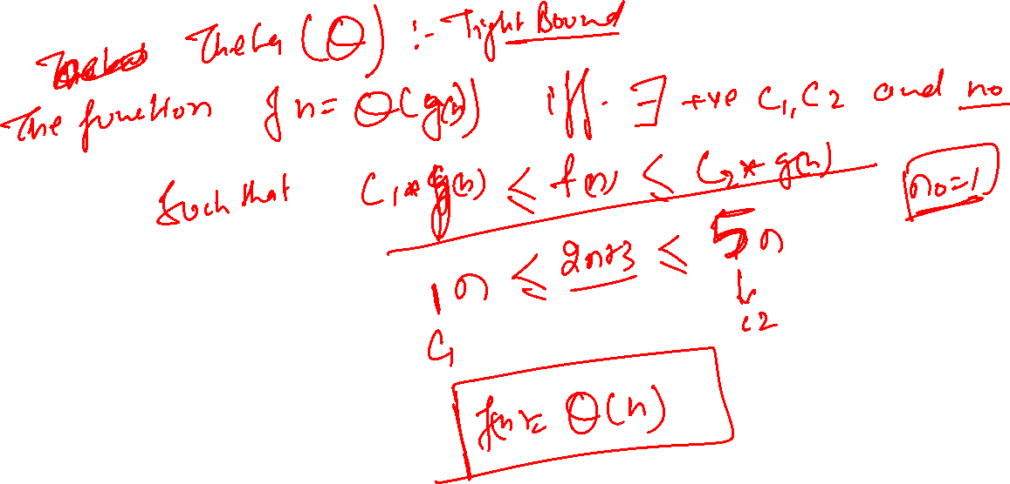

Slide 26
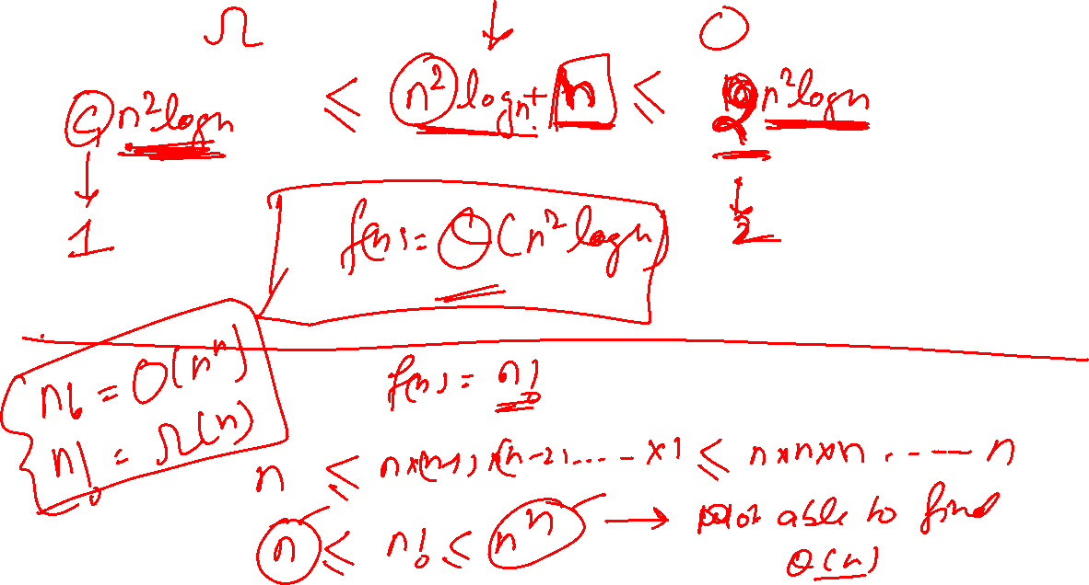

Slide 27
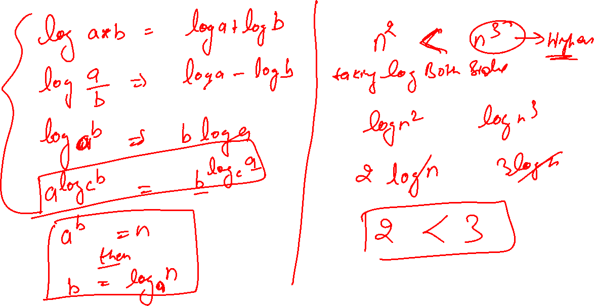

Slide 28
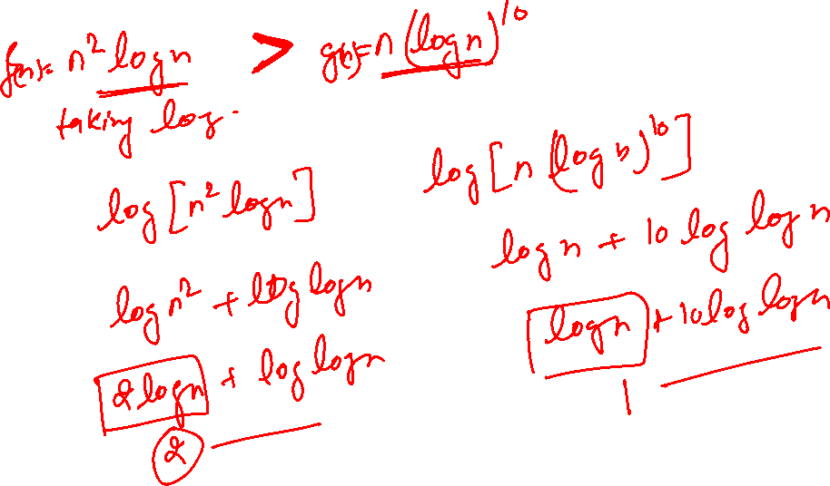

Slide 29
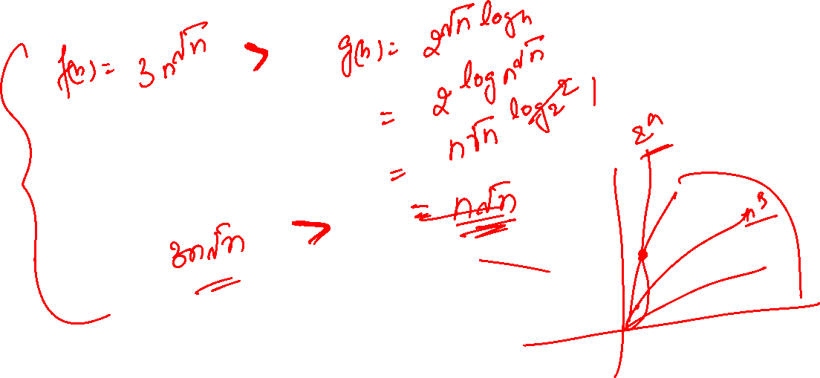

Slide 30
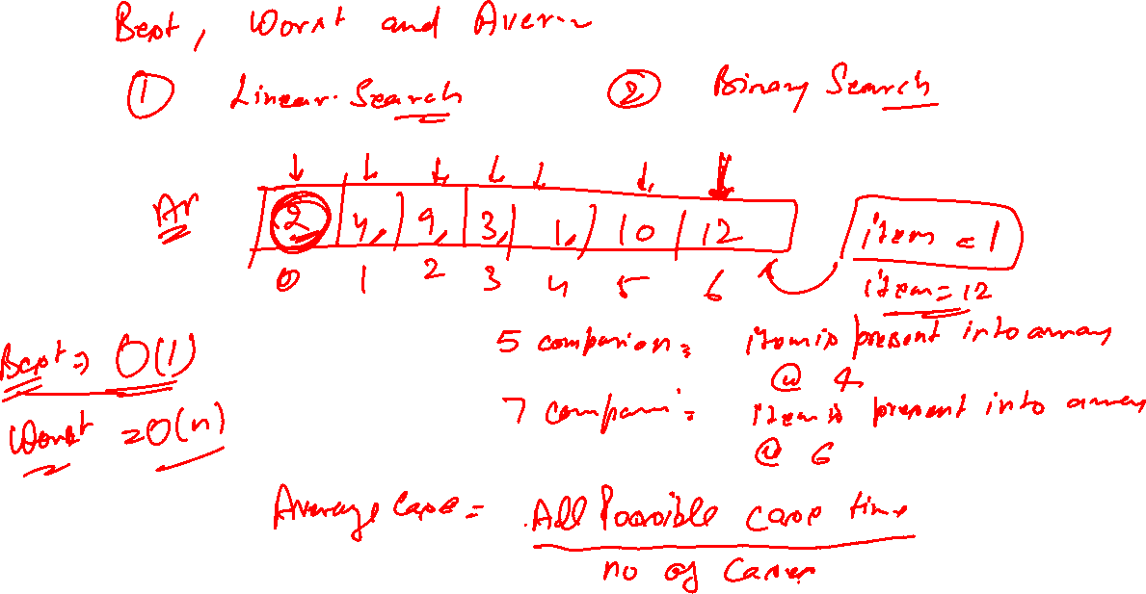

Slide 31
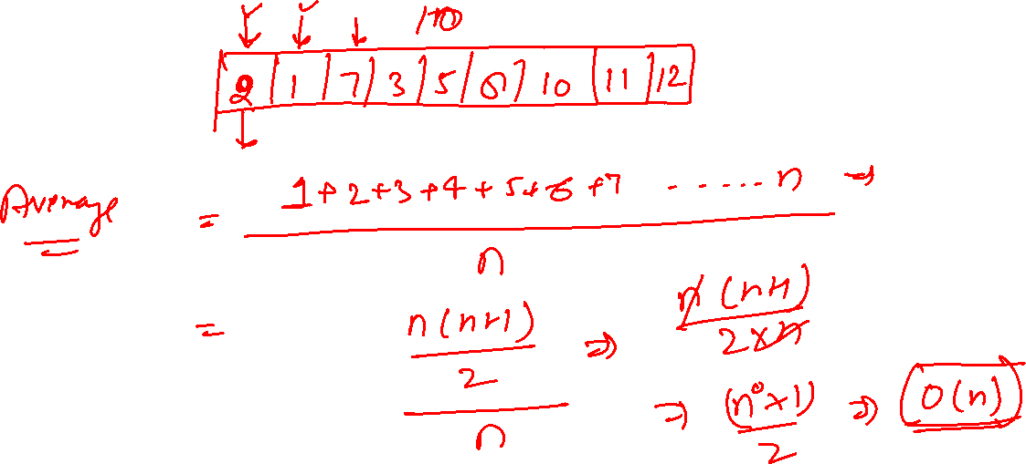

Slide 32
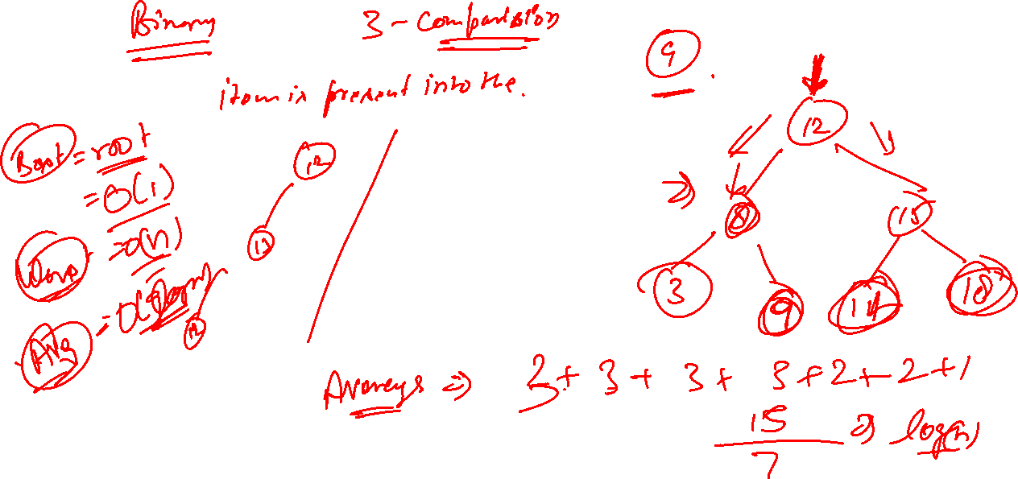

Slide 33
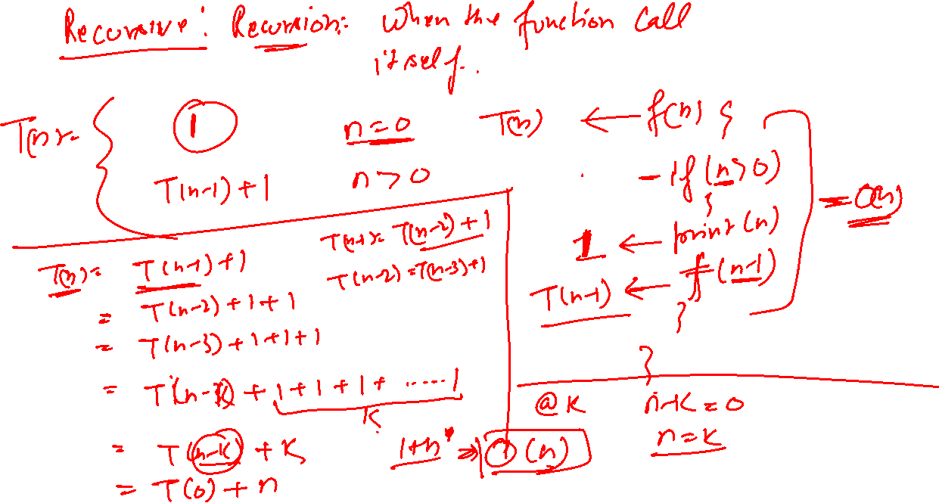

Slide 34
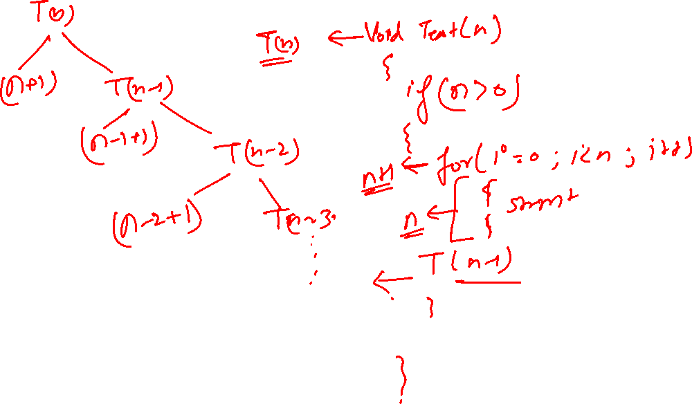

Slide 35
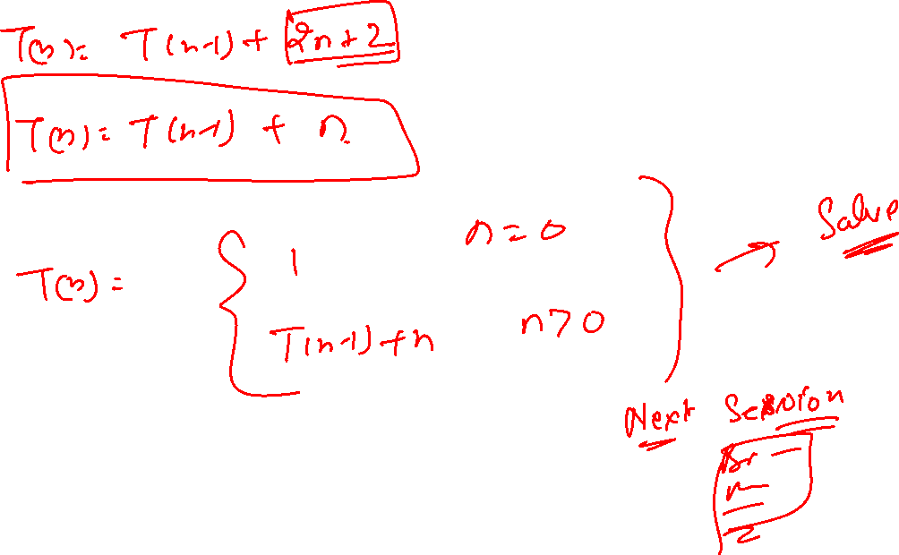

Slide 36
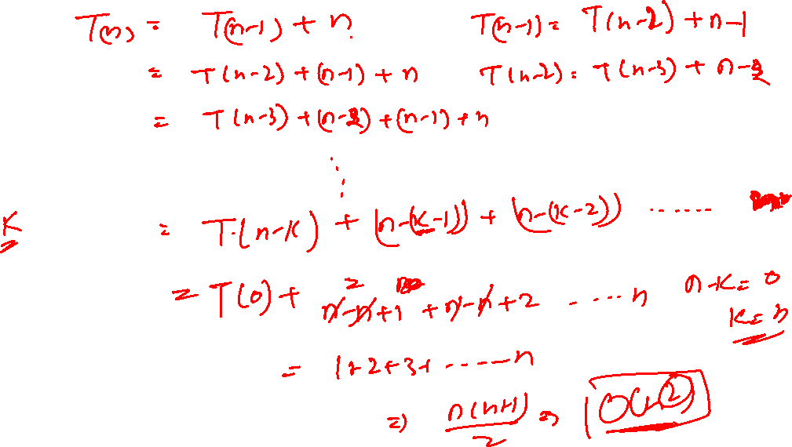

Slide 43
Fundamentals of Algorithmic Problem Solving
1.Understanding the Problem
2.Ascertaining the Capabilities of the Computational Device
3.Choosing between Exact and Approximate Problem Solving
4.Algorithm Design Techniques
5.Designing an Algorithm and Data Structures
6.Methods of Specifying an Algorithm
7.Proving an Algorithm’s Correctness
8.Analyzing an Algorithm
9.Coding an Algorithm

Slide 44
Need of Analysis
Any Problem P has multiple
Such as A1,A2 and A3
Let P be any problem are have many or multiple solution.
For making a performance comparison on among different solution i.e. which one is best for doing this we analyze the algorithm
In terms of time and space .

Slide 45
Complexities
Time and space required by the algorithm to solve a particular problem
Time Complexity : Number of unit operations
Space Complexity : Memory requirement
Time Complexity is calculated in terms of units / step which is independent from Machine or Platform. (before expressing in language)

Slide 46
Order of magnitude : frequency of fundamental operations in the step.
Let X <- X+Y here order of magnitude is one
For i<- (1 to n) here order of magnitude is n
For i<- (1 to n)
For j<- (1 to n)
x<- x+y
Here order of magnitude is n*n

Slide 47
Asymptotic
Asymptotic is a term used in mathematics to describe a line that approaches a curve or a function that approaches a value as a variable increases.

Slide 48
Asymptotic Notation
Let f & g be the function from the set of integers or real to the set of real number.

Slide 49
Big oh (O) : [Upper Bound Function]
f(n) is O(g(n)) iff there exist a constant c & k Such that : f(n) <= c.g(n) whenever n>=k,c>0

Slide 50
Big Omega ( ) : [Lower Bound Function]
f(n) is (g(n)) iff there exist a constant c & k
Such that : f(n) >= c.g(n) whenever n>=k,c>0

Slide 51
Example
1+n+(n*n)

Slide 52
Theta [Tight Bound]
f(n) is (g(n)) iff f(n) is O(g(n)) & f(n) is (g(n))

Slide 53
Time Complexity
The time complexity of an algorithm is the amount of computer time it needs to run to compilation.
We introduce a variable, count into the program statement to increment count with initial value 0.Statement to increment count by the appropriate amount are introduced into the program.
This is done so that each time a statement in the original program is executes
count is incremented by the step count of that statement.

Slide 54
Algorithm:
Algorithm sum(a,n)
{
s= 0.0;
count = count+1;
for I=1 to n do
{
count =count+1;
s=s+a[I];
count=count+1;
}
count=count+1;
count=count+1;
return s;
}

Slide 55
Contd..
If the count is zero to start with, then it will be 2n+3 on termination. So each invocation of sum execute a total of 2n+3 steps.
The second method to determine the step count of an algorithm is to build a table in which we list the total number of steps contributes by each statement.
First determine the number of steps per execution (s/e) of the statement and the total number of times (ie., frequency) each statement is executed. By combining these two quantities, the total contribution of all statements, the step count for the entire algorithm is obtained.

Slide 56
Algorithm for Time Complexity
Statement | S/e | Frequency | Total
1. Algorithm Sum(a,n) 2.{ 3. S=0.0; 4. for I=1 to n do 5. s=s+a[I]; 6. return s; 7. } | 0 0 1 1 1 1 0 | - - 1 n+1 n 1 - | 0 0 1 n+1 n 1 0
Total |  |  | 2n+3

Slide 58
Space Complexity
The space complexity of an algorithm is the amount of money it needs to run to compilation,
Example:
Algorithm abc(a,b,c)
{
return a+b++*c+(a+b-c)/(a+b) +4.0;
}
The Space needed by each of these algorithms is seen to be the sum of the following component.
A fixed part that is independent of the characteristics (eg:number,size)of the inputs and outputs.
The part typically includes the instruction space (ie. Space for the code), space for simple variable and fixed-size component variables (also called aggregate) space for constants, and so on.

Slide 59
Contd..
A variable part that consists of the space needed by component variables whose size is dependent on the particular problem instance being solved, the space needed by referenced variables and the recursion stack space.
The space requirement s(p) of any algorithm p may therefore be written as,
S(P) = c+ Sp(Instance characteristics)
Where ‘c’ is a constant.

Slide 60
Types of Algorithms
Brute Force Algorithm
Recursive Algorithm
Divide and Conquer Algorithm
Dynamic Programming Algorithms
Greedy Algorithm
Backtracking Algorithm

Slide 61
Brute Force Algorithm
A Brute Force Algorithm is the straightforward approach to a problem i.e., the first approach that comes to our mind on seeing the problem.
More technically it is just like iterating every possibility available to solve that problem.

Slide 62
Recursive Algorithm
In recursion, a problem is solved by breaking it into sub problems of the same type and calling own self again and again until the problem is solved with the help of a base condition

Slide 63
Divide and Conquer
In Divide and Conquer algorithms, the idea is to solve the problem in two sections
The first section divides the problem into subproblems of the same type.
The second section is to solve the smaller problem independently and then add the combined result to produce the final answer to the problem.

Slide 64
Dynamic Programming
This type of algorithm is also known as the memorization technique because in this the idea is to store the previously calculated result to avoid calculating it again and again.
In Dynamic Programming, divide the complex problem into smaller overlapping sub problems and storing the result for future use.

Slide 65
Greedy Algorithm
In the Greedy Algorithm, the solution is built part by part.
The decision to choose the next part is done on the basis that it gives the immediate benefit.
It never considers the choices that had taken previously.

Slide 66
Backtracking Algorithm
The problem is solved in an incremental way i.e. it is an algorithmic-technique for solving problems recursively by trying to build a solution incrementally, one piece at a time
By removing those solutions that fail to satisfy the constraints of the problem at any point of time

Slide 67
Fundamentals of Data Structure
Data Structure is a way of organizing a data that considers not only the items stored, but also their relationship to each other in a logical manner.
Advance knowledge about the relationship between data items allows designing of efficient algorithms for the manipulation of data in the following ways.
How to store a collection of data in memory,
What operations we can perform on that data
The algorithms for those operations, and
How time and space efficient those algorithms are

Slide 68
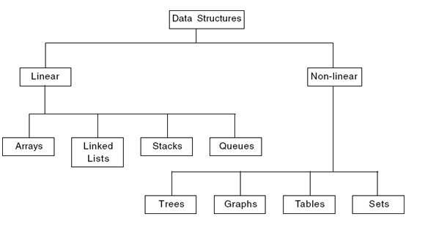
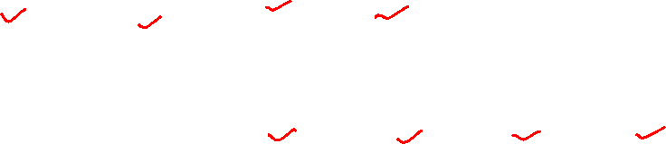
Classification Data Structures

Slide 69
Types of Data Structure
Linear Data Structures
Items are arranged in Sequential order
Ex.Arrays, Linked list, Stacks, Queues.
Non Linear data Structures
Data Items are not in Sequential order
Ex. Tree, Graph

Slide 70
Arrays
An array is a fixed size sequence collection of elements of the same data type.
It is simply a grouping of like type data .
In its simplest form an array can be used to represent a list of numbers or a list of names.

Slide 71
One Dimensional Array
A list of items can be given one variable name using only one subscript and such a variable is called single subscripted variable or a one dimensional array.
For eg : if we want to represent a set of five numbers say (3,4,5,6,7) by an array variable number then we may declare the variable number as follows.
int no.[5];
The values to the array elements can be assigned as follows:
No.[0] =35;
No.[1] = 40;
No.[2] =20;
No .[3]= 51;
No .[4]=19;
Eg: Float height [50];
Height[0] refers to the first element of array

Slide 72
Values[0]
Values[1]

Slide 73
Declaration of One Dimensional Array
Datatypevariable -name [size];
Eg: int group [10];

Slide 74
Initialization of One Dimensional Array
After an array is declared ,its elements must be initialized.
Otherwise ,they will contain “garbage”
An array can be initialized at either at the following stages
compile time
run time

Slide 75
Compile Time Initialization
The general form of initialization of array is
Type array - name [size] ={ list of values}
The values in the list are repeated by commas. For eg : the statements,
int number [3]={0,0,0}
Will declare the variable number as an array of size 3 and will assign zero to each element.

Slide 76
Run Time Initialization
An array can be explicitly initialized at runtime.
This approach is usually applied for initializing large arrays.
For eg consider the following segments of C program.
……………..
……………………………………
for(i=0;i<100;i=i+1)
{
ifi<50
sum[i]=0.0;
else
sum[i]=1.0
}…………..
………….
The first 50 elements of the array are initialized to 0 while the remaining 50 elements are initialized to 1.0 at runtime

Slide 77
Two Dimensional Array
In maths ,we represent a particular value m by a matrix by using two subscript such as Vij.
V[4][3]
Syntax:
Type array – name [ row-size] [column-size]

Slide 78
Initializing Two Dimensional Array
Like the one dimensional array,two dimensional array may be initialized by following their declaration with a list of initial values enclosed in braces.
For eg: int table [2] [3] ={ 0,0,0,1,1,1}

Slide 79
Multidimensional Array
The general form of multidimensional array is
Type array- name[s1][s2][s3]……[sn]
Where s1 is the size
Eg:
int survey [3][5][12];
If we are reading or writing two-dimensional array, two loops are required.
Similarly the array of ‘n’ dimensions would require ‘n’ loops.

Slide 80
Linked List
Linked list consist of a series of structures, which are not necessarily in adjacent in memory.
The structure is called as Node.
Each structure (node) contains :
Element
Pointer to a structure containing next element. – It is called as Next Pointer
The Last cell‟s Next pointer point to NULL,
A single node is represented as follows
Pointer :A pointer is a variable that contains the address of another variable

Slide 81
Linked list with actual pointer value

Slide 82
Types of Linked List
Single Linked List
Doubly Linked List
circular Linked List

Slide 83
Single Linked List
A singly linked list is a list in which each node contains only one link field pointing to the next node in the list.
Basic linked List Operations
The basic operations to be performed on linked lists are as
Creation - Create a linked list
Insertion - insert a new node at the specified position
Deletion - delete the specified node
Traversing - to display every node information
Find - Search a particular data

Slide 84
Creating Linked List
The malloc( ) function is used to allocate a block of memory to a node in a linked list.
The create function is used to create a dummy header node.
List Create( )
{
List L;
L=(struct Node *)malloc(sizeof(struct Node));
L->Element=0;
L->Next=NULL;
return L;
}

Slide 85
Insertion
Insertion require obtaining a new cell from the system by using a malloc call and then execute two pointer change

Slide 86
Insertion in single linked list

Slide 87
Deletion

Slide 88
Doubly Linked List
A node contains pointers to previous and next element. One can move in both directions.
A node contain three fields.
i)data
ii)address to previous cell
iii)address to next cell

Slide 89
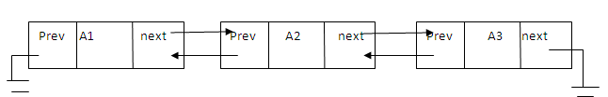
Doubly linked list

Slide 90
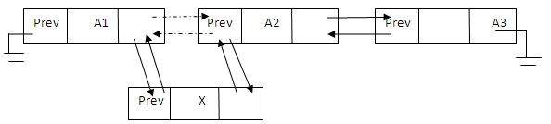
Insertion In Doubly Linked List

Slide 91
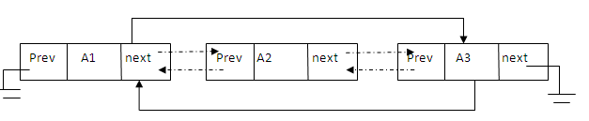
Deletion in Doubly linked list

Slide 92
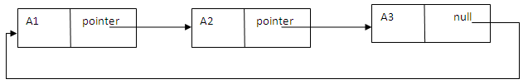
Circular Linked List

Slide 93
Stack
Stack is a last-in-first-out strategy data structure; this means that the element stored in last will be removed first.
Solving Recursion - recursive calls are placed onto a stack, and removed from there once they are processed.
Evaluating post-fix expressions
Solving Towers of Hanoi
Backtracking
Depth-first search
Converting a decimal number into a binary number

Slide 94
Operations Of Stack
i)push(insert) -- > insert an element to the stack
ii)pop(delete)---> delete one element from the stack
Principle of stack is known as LIFO(last in first out)

Slide 95
Insertion: - Push
If top>= size then
Print”stack is full”
Else
Top=top+1
A[top]=item
Endif
Stop

Slide 96
Deletion- Pop
Routine to delete an element in stack
If top<1 then
Print”stack is empty”
Else
Item=a[top]
Top=top-1
Endif
Stop

Slide 97
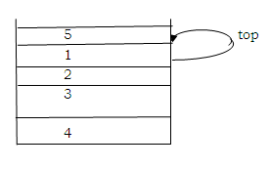
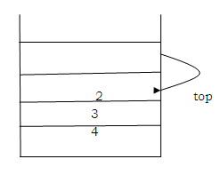
After Insertion and Deletion On a Stack

Slide 98
Queue
Queue is a first-in-first-out data structure. The element that is added to the queue data structure first, will be removed from the queue first.
Dequeue
priority queue
and circular queue
Queue has the following application uses:
Access to shared resources (e.g., printer)
Multiprogramming
Message queue

Slide 99
Three States Of The Queue With This Representation
Queue is empty
FRONT=0
REAR-0
Queue is full
REAR=N
FRONT=1
Queue contain element >= 1
FRONT<= REAR
NUMBER OF ELEMENT =REAR-FRONT+1

Slide 100
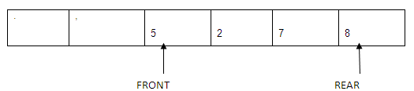
Enqueue : To enqueueanelement , we increment queue size and queue rear, then set QUEUE[rear] = element. Ex: Insert/enqueue 8

Slide 101
Routine for Enqueue in Queue
If (rear = N) then
Print”queue is full”
Exit
Else
If(rear=0) and (front=0) then
Front=1
Endif
Rear=rear+1
Q(rear)=item
End if
stop

Slide 102
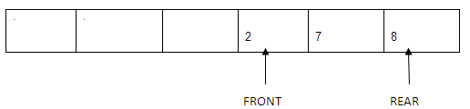
Dequeue: To dequeue an element, we set the return value to QUEUE[front], decrement queue size, and then increment queue front.

Slide 103
Routine for Dequeue
If(front=0)then
Print”queue is empty”
Exist
Else
Item=Q(front)
If(front=rear)
Rear=0
Front=0
Else
Front=front+1
Endif
Endif
Stop

Slide 104
Trees
Tree is a hierarchical data structure.
The very top element of a tree is called the root of the tree.
Except the root element every element in a tree has a parent element, and zero or more children elements.
All elements in the left sub-tree come before the root in sorting order, and all those in the right sub-tree come after the root.

Slide 105
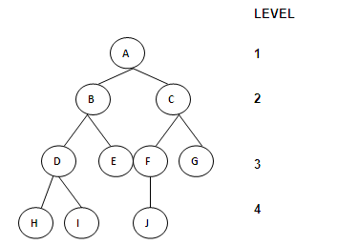

Slide 106
Graph
Graph is a networked data structure that connects a collection of nodes called vertices, by connections, called edges.
An edge can be seen as a path or communication link between two nodes.
These edges can be either directed or undirected. If a path is directed then you can move in one direction only
while in an undirected path the movement is possible in both directions.

Slide 107
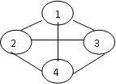

Slide 108
Summary
The specification of algorithm
Types of algorithm
What is Data Structure
Types of Data structure

Slide 109
DOUBTS???????

Slide 110

5 min break
This a 5 min break for you
Have a glass of water
Take a deep breath
Note down any doubt you have till now
Join back

Slide 111
Recursion
Recursion may have the following definitions:
-The nested repetition of identical algorithm is recursion.
-It is a technique of defining an object/process by itself.
-Recursion is a process by which a function calls itself repeatedly until some specified condition has been satisfied.
When to use recursion:
Recursion can be used for repetitive computations in which each action is stated in terms of previous result. There are two conditions that must be satisfied by any recursive procedure.
Each time a function calls itself it should get nearer to the solution.
There must be a decision criterion for stopping the process.

Slide 112
Recursive algorithm
A recursive algorithm is an algorithm which calls itself with "smaller (or simpler)" input values, and which obtains the result for the current input by applying simple operations to the returned value for the smaller (or simpler) input. More generally if a problem can be solved utilizing solutions to smaller versions of the same problem, and the smaller versions reduce to easily solvable cases, then one can use a recursive algorithm to solve that problem. For example, the elements of a recursively defined set, or the value of a recursively defined function can be obtained by a recursive algorithm.
If a set or a function is defined recursively, then a recursive algorithm to compute its members or values mirrors the definition. Initial steps of the recursive algorithm correspond to the basis clause of the recursive definition and they identify the basis elements. They are then followed by steps corresponding to the inductive clause, which reduce the computation for an element of one generation to that of elements of the immediately preceding generation.

Slide 113
Contd…
Example: Factorial Calculation
We know that the factorial of n (n >= 0) is calculated by n! = n * (n-1) * (n-2) * ... * 2 * 1. Note that the product of (n-1) * (n-2) * ... * 2 * 1 is exactly (n-1)!. Thus we can write the expression as n! = n * (n-1)!, which is the recursive expression of the factorial calculation.
What is the base case? What is the recursive step?
public class RecursiveFactorial { public static void main (String[] args) { for (int i = 1; i < 10; i++) System.out.println(i + "\t" + factorial(i)); } static int factorial (int n) { if (n < 2) return 1; // base case else return n * factorial(n-1); // recursive case } }

Slide 114
Contd….
The above recursion is called a linear recursion since it makes one recursive call at a time. The loop equivalent:
public static int factorial(int n) { int result = 1; for (int i = 2; i <= n; i++) result *= i; return result; }

Slide 115
Summary
Performance Analysis
Three Cases
Asymptotic Notations
Recursive Algorithms

Slide 116
DOUBTS??????

